Slide 1

Artificial Intelligence (AI)

Slide 2

AGENDA
Model Training using Regression (Practical)
Model Traning using Classification (Practical)
Prediction on unseen data (Practical)
Evaluation Metrices
Evaluation Metrices for Regression
Evaluation Metrices for Classification

Slide 3
Evaluation Metrics
Back to main

Slide 4
Evaluation Metrics
Evaluation:
Always good in any field right! In the case of machine learning, it is best the practice.
Used to measure the quality of the statistical or machine learning model.
The idea of building machine learning models works on a constructive feedback principle. Evaluation metrics explain the performance of a model.
An important aspect of evaluation metrics is their capability to discriminate among model results.
Evaluation helps you understand more about your Model. It tells whether your model has memorized or learnt. This is very important if your model has only memorized instead of learning, the model performs well for known data and making the model inefficient.

Slide 5
Why Evaluation is necessary for successful model?
Overfitting and underfitting are the two biggest causes for poor performance of machine learning algorithms.
Overfitting:
Occurs when the Model performs well for a particular set of data(Known Data), and may therefore fail to fit additional data(Unknown Data) or predict future observations reliably.
works well for training examples but not for unseen data.
Underfitting:
Occurs when the model cannot adequately capture the underlying structure of the data.
Neither works well for training examples and also for unseen data.
Generalization:
Refers to how well the concepts learned by a machine learning model apply to specific examples not seen by the model when it was learning.
demonstrate how well is a trained model to classify or forecast unseen data.

Slide 6
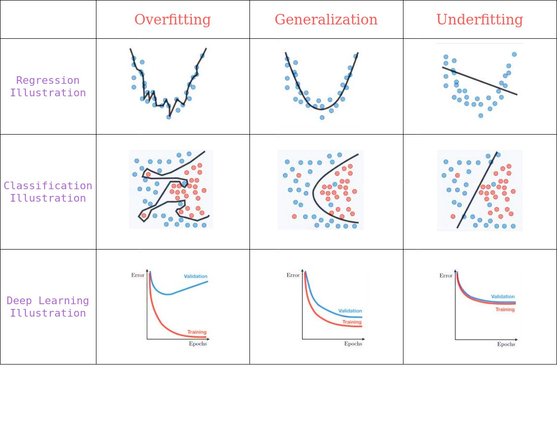
Why Evaluation is necessary for successful model?
https://medium.com/

Slide 7
Evaluation Metrics
There are different metrics for the tasks of classification, regression, ranking, clustering, topic modeling, etc. Some of the metrics are as follows:
Classification Metrics:
Confusion Matrix
Classification Accuracy.
Logarithmic loss.
Area under Curve.
F1 score.
Regression Metrics:
Mean Absolute Error.
Mean Squared Error.
Root Mean Square Error.
Back to main

Slide 8
Regression Metrics:
Back to main

Slide 9
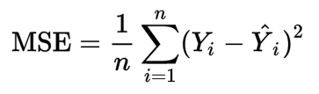
Mean Squared Error
Mean Squared Error(MSE)
Perhaps the most popular metric used for regression problems.
It essentially finds the average squared error between the predicted and actual values.
The MSE is a measure of the quality of an estimator — it is always non-negative, and values closer to zero are better.
where n is number of data points, yᵢ is observed value and ŷᵢ is predicted value.
In regression analysis, plotting is a more natural way to view the overall trend of the whole data.
Simply MSE tells you how close a regression line is to a set of points. It does this by taking the distances from the points to the regression line (these distances are the “errors”) and squaring them.
To minimize MSE, the model could be more accurate, which would mean the model is closer to actual data.
The lower the MSE,the better the forecast.

Slide 10
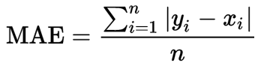
Mean Absolute Error
Mean Absolute Error(MAE):
Measures the average magnitude of the errors in a set of predictions, without considering their direction.
It’s the average over the test sample of the absolute differences between prediction and actual observation where all individual differences have equal weight.
where n is number of data points, xᵢ is true value and yᵢ is predicted value.

Slide 11
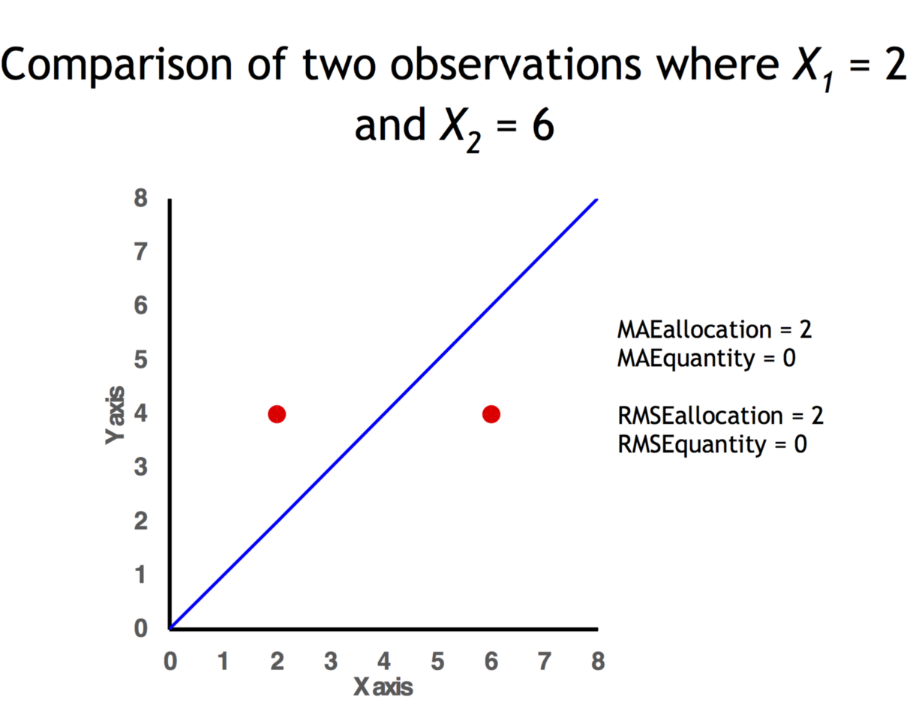
Mean Absolute Error
It is also possible to identify the types of difference by looking at an ( x , y ) plot.
Quantity difference exists when the average of the X values does not equal the average of the Y values.
Allocation difference exists if and only if points reside on both sides of the identity line.
MAE is known to be more robust to the outliers than MSE.
The main reason being that in MSE by squaring the errors, the outliers (which usually have higher errors than other samples) get more attention and dominance in the final error and impacting the model parameters.

Slide 12
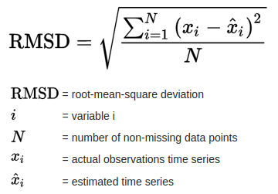
Root Mean Square Error
Root Mean Square Error or Root Mean Square Deviation __ is the square root of the average of squared errors.
RMSE is the standard deviation of the residuals (prediction errors).
RMSE is a measure of how spread out these residuals are. In other words, it tells you how concentrated the data is around the line of best fit.
RMSE is always non-negative, and a value of 0 (almost never achieved in practice) would indicate a perfect fit to the data.
In general, a lower RMSD is better than a higher one.
Back to main

Slide 13
Classification Metrics:
Back to main

Slide 14
Confusion Matrix:
Confusion Matrix:
A confusion matrix is a table that is often used to describe the performance of a classification model (or “classifier”) on a set of test data for which the true values are known.
There are 4 terms you should keep in mind:
True Positive (TP) — A true positive is an outcome where the model correctly predicts the positive class.
True Negative (TN) — A true negative is an outcome where the model correctly predicts the negative class.
False Positive (FP) — A false positive is an outcome where the model incorrectly predicts the positive class.
False Negative (FN) — A false negative is an outcome where the model incorrectly predicts the negative class.

Slide 15
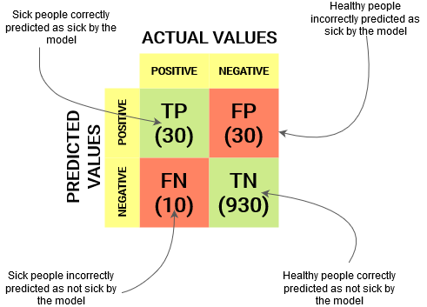
Confusion Matrix:
https://www.analyticsvidhya.com/

Slide 16


Accuracy
Accuracy:
Accuracy is one metric for evaluating classification models.
Writing this in terms of True Positive and True Negative,

Slide 17
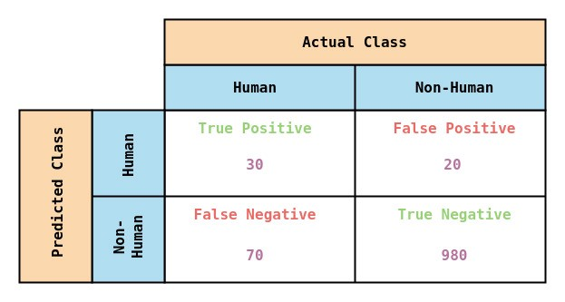
Example
Lets consider one example and try find its accuracy.
Assume your trying to build a simple binary classification to classify Human image from non-human image. Say you have 1100 images(100 are human image and 1000 images are non-human), with below confusion matrix.
https://medium.com/

Slide 18
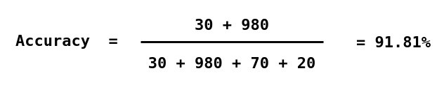
Accuracy
Inferring from Confusion Matrix,
From the 100 Human Images, your model has predicted 30 images as Human (TP) and remaining 70 images as Non-Human (FN).
From the 1000 Non-Human Images, your model has predicted 980 images as Non-Human (TN) and remaining 20 images as Human (FP).
Now calculate the accuracy for your model,
Now calculate the accuracy for your model,

Slide 19

Accuracy
Classification Accuracy is great, but gives us the false sense of achieving high accuracy.
Can’t resist myself from adding this meme
https://medium.com/

Slide 20
Logarithmic loss
Logarithmic loss:
Logarithmic loss indicates how close a prediction probability comes to the actual/corresponding true value. As a result, it turns out that maximizing the likelihood is equivalent to minimizing the mean square error (MSE),
It usually works well with multi-class classification.
Working of Log loss, the classifier should assign a probability for each and every class of all the samples.
If there are N samples belong to M class, then we calculate the Log loss in this way :
Now the Terms,
y_ij indicates whether sample i belongs to class j.
p_ij – the probability of sample i belongs to class j.
Rang of log loss is [0,1). When the log loss is near 0 it indicates high accuracy and when away from zero then, it indicates lower accuracy.
Let me give you a bonus point, minimizing log loss gives you higher accuracy for the classifier.

Slide 21
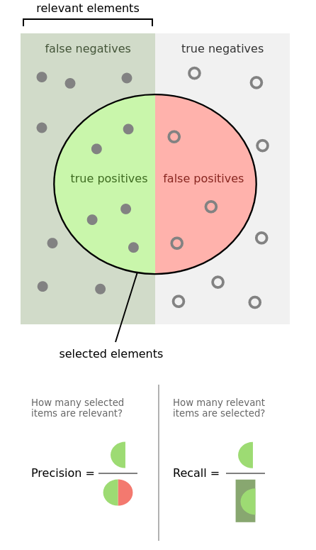
Precision and Recall
Precision:
(also called positive predictive value) in classifying the data instances.
Precision should ideally be 1 (high) for a good classifier. Precision becomes 1 only when the numerator and denominator are equal i.e TP = TP +FP, this also means FP is zero.
while recall (also known as sensitivity) is the fraction true positive rate for data instances.
Precision should ideally be 1 (high) for a good classifier. Precision becomes 1 only when the numerator and denominator are equal i.e TP = TP +FN, this also means FN is zero.

Slide 22
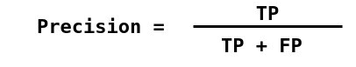
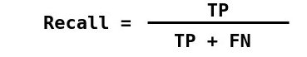
Precision and Recall
In classification, precision is the number of true positive instances to the total number of instances labeled as belonging to positive class.
Recall is the number of true positive instances to the total number of instances actually belong to positive class.

Slide 23
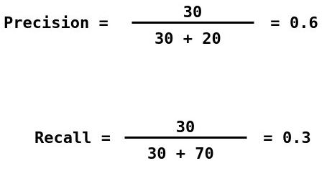
Example
Calculating precision and recall for the example from accuracy,
Your model, could predict human 60% of the time and it correctly identifies only 30% of the human.

Slide 24
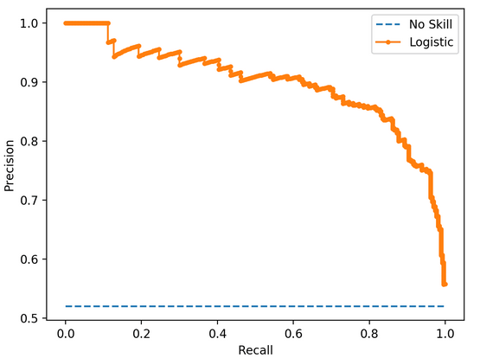
PR Curve
A PR curve is simply a graph with Precision values on the y-axis and Recall values on the x-axis. In other words,
The PR curve contains TP/(TP+FN) on the y-axis and TP/(TP+FP) on the x-axis.
It is desired that the algorithm should have both high precision, and high recall. However, most machine learning algorithms often involve a trade-off between the two.

Slide 25
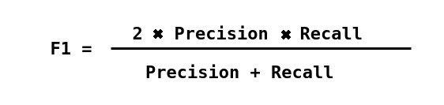
F1 Score
Depending on application, you may want to give higher priority to recall or precision.
But there are many applications in which both recall and precision are important. Therefore, it is natural to think of a way to combine these two into a single metric.
One popular metric which combines precision and recall is called F1-score, which is the harmonic mean of precision and recall defined as:
F1 Score becomes 1 only when precision and recall are both 1.
F1 score becomes high only when both precision and recall are high.
Back to main

